Slide 1
Lecture 3
Topics: 2D Arrays
Chapter 8, Sections 8.1 – 8.3

Slide 2


Two-Dimensional (2D) Arrays
Data in a table can be represented using a 2D array.
Matrices = 2D arrays.
You have rows and columns.

Slide 3
Declaring and creating 2D arrays
// Declare array matrix
int[][] matrix;
// Create array
matrix = new int[10][10];
// Combine declaration and creation in one statement
int[][] matrix = new int[10][10];
dataType[][] varName = new dataType[rows][columns];
The number of rows
that you want.
The number of columns
that you want.

Slide 4
Declaring and creating 2D arrays
int[][] matrix = new int[10][10];
int matrix[][] = new int[10][10];
double[][] x;
x = new double[4][2];

Slide 5
How would you declare an array for this table?
4 columns
34 | 98 | 30 | 37
22 | 1 | 3 | 82
3 | 6 | 7 | 99
31 | 76 | 567 | 112
87 | 5 | 222 | 42
54 | 46 | 101 | 96
6 rows
int[][] matrix = new int[6][4];

Slide 6

How would you declare an array for this table?
34 | 98 | 30 | 37
int[] array = new int[4];
OR
int[][] array = new int[1][4];
1D arrays can be represented with 2D notation!
That’s because each row in a 2D array is a 1D array.

Slide 7

Initializing 2D arrays
34 | 98 | 30 | 37
22 | 1 | 3 | 82
3 | 6 | 7 | 99
31 | 76 | 567 | 112
87 | 5 | 222 | 42
54 | 46 | 101 | 96
int[][] matrix = new int[6][4];
matrix[0][0] = 34;
matrix[0][1] = 98;
matrix[0][2] = 30;
matrix[0][3] = 37;
Repeat for all rows
Rows in 2D arrays start at 0.
Columns in 2D arrays start at 0.

Slide 8
Initializing 2D arrays: Shorthand initialization
34 | 98 | 30 | 37
22 | 1 | 3 | 82
3 | 6 | 7 | 99
31 | 76 | 567 | 112
87 | 5 | 222 | 42
54 | 46 | 101 | 96
int[][] matrix = { { 34, 98, 30, 37 },
{ 22, 1, 3, 82 },
{ 3, 6, 7, 99 },
{ 31, 76, 567, 112 },
{ 87, 5, 222, 42 },
{ 54, 46, 101, 96 } };
Each row goes inside its own set of braces.
The elements are separated by commas.
int[][] arr = { { 34, 98 },
{ 22, 1 },
{ 3, 6 } };
int[][] arr = { {34, 98}, {22, 1}, {3, 6} };

Slide 9
Accessing elements in 2D arrays
int[][] matrix = { { 34, 98, 30, 37 },
{ 22, 1, 3, 82 },
{ 3, 6, 7, 99 },
{ 31, 76, 567, 112 },
{ 87, 5, 222, 42 },
{ 54, 46, 101, 96 } };
What if I wanted to print out the value of the element
in the 4th row and the 3rd column?
4th row : row index of 3
3rd column : column index of 2
S.O.P.L(matrix[3][2]);

Slide 10
Determining the row and column lengths
int[][] matrix = { { 34, 98, 30, 37 },
{ 22, 1, 3, 82 },
{ 3, 6, 7, 99 },
{ 31, 76, 567, 112 },
{ 87, 5, 222, 42 },
{ 54, 46, 101, 96 } };
Using the length property on a 2D array variable name returns the number of rows in the array.
matrix.length
6
What happens if I type matrix[0]?
{34, 98, 30, 37}
Returns a 1D array!
To get the number of columns:
matrix[0].length
4
Can also use:
matrix[1].length
matrix[2].length
...
matrix[5].length

Slide 11
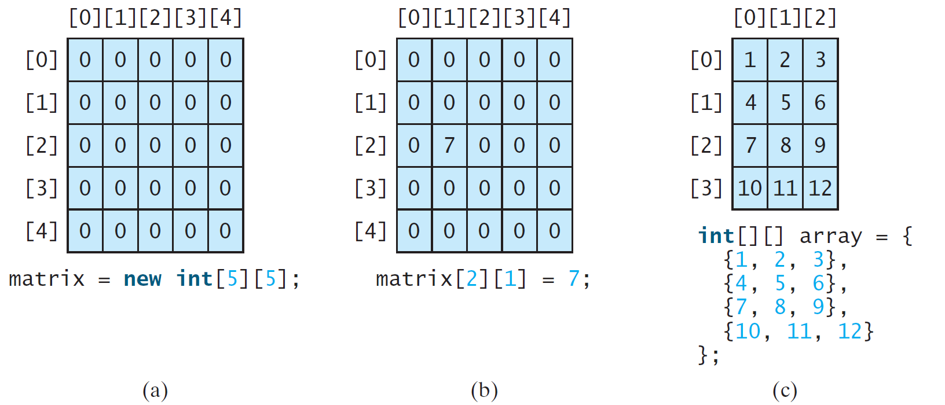
2D Arrays: Illustration
matrix.length
5
array.length
4
matrix[0].length
5
array[0].length
3

Slide 12

Working with 2D arrays
Processing 2D arrays almost always requires nested for-loops.
You need to choose whether your outer loop represents the rows or the columns.
This depends on the problem that you are trying to solve.

Slide 13
Example: Printing the elements in a 2D array
Print the elements of an array so that the output looks like the sample output below.
You can hard code the 2D array (i.e. no input required).
Sample Data #1
1 5 3 2
10 8 15 12
2 15 4 1
Output
Row 0: 1 5 3 2
Row 1: 10 8 15 12
Row 2: 2 15 4 1

Slide 14
Memory
public class Test
{
public static void main(String[] args)
{
int[][] array1 = { { 1, 5, 3, 2 },
{ 10, 8, 15, 12 },
{ 2, 15, 4, 1 } };
for (int i = 0; i <= 2; i++)
{
S.O.P("Row " + i + ": ");
for (int j = 0; j <= 3; j++)
{
S.O.P(array1[i][j] + " ");
}
S.O.P.L();
}
}
}
array1:
i: 0
j: 0
1 | 5 | 3 | 2
10 | 8 | 15 | 12
2 | 15 | 4 | 1
1
2
3
1
2
3
4
0
1
2
3
4
0
1
2
3
4
Output
Row 0:
Row 1:
Row 2:
1
5
3
2
10
8
15
12
2
15
4
1

Slide 15
public class Test
{
public static void main(String[] args)
{
int[][] array1 = { { 1, 5, 3, 2 },
{ 10, 8, 15, 12 },
{ 2, 15, 4, 1 } };
for (int i = 0; i <= 2; i++)
{
S.O.P("Row " + i + ": ");
for (int j = 0; j <= 3; j++)
{
S.O.P(array1[i][j] + " ");
}
S.O.P.L();
}
}
}
Do you see any future problems with this code?
What happens if I change my 2D array to have different dimensions?
Then you have to change the for-loop if you change your array.
Can you think of a way to avoid having to change the for-loop?
The length property!!

Slide 16
public class Test
{
public static void main(String[] args)
{
int[][] array1 = { { 1, 5, 3, 2 },
{ 10, 8, 15, 12 },
{ 2, 15, 4, 1 } };
for (int i = 0; i < array1.length; i++)
{
S.O.P("Row " + i + ": ");
for (int j = 0; j < array[i].length; j++)
{
S.O.P(array1[i][j] + " ");
}
S.O.P.L();
}
}
}
This is because your rows can have different numbers of columns! We will talk about those kinds of arrays later.
Why use < instead of <= ?
array1.length is 3, but the indices for the rows starts at 0 and goes up to 2.

Slide 17
Example: Initializing the elements in a 2D array with user input
Initialize an array that has 3 rows and 4 columns with user input. Your input (and output should match the sample runs below. Then print out the 2D array that was entered.
Enter row 0: 3 9 7 3
Enter row 1: 2 -8 7 1
Enter row 2: -3 15 21 4
Your 2D array:
3 9 7 3
2 -8 7 1
-3 15 21 4
Enter row 0: 13 5 -7 -11
Enter row 1: 1 9 -107 3
Enter row 2: 16 18 19 -4
Your 2D array:
13 5 -7 -11
1 9 -107 3
16 18 19 -4

Slide 18
import java.util.Scanner;
public class Test
{
public static void main(String[] args)
{
Scanner kb = new Scanner(System.in);
int[][] array1 = new int[3][4];
for (int i = 0; i <= 2; i++)
{
S.O.P("Enter row " + i + ": ");
for (int j = 0; j <= 3; j++)
{
array1[i][j] = kb.nextInt();
}
S.O.P.L();
}
S.O.P.L("Your 2D array:");
for (int i = 0; i <= 2; i++)
{
for (int j = 0; j <= 3; j++)
{
S.O.P(array1[i][j] + " ");
}
S.O.P.L();
}
}
}

Slide 19
Example: Initializing the elements in a 2D array with user input
Initialize an array where the dimensions and elements are specified by the user. Your input and output should match the sample runs below. Then print out the 2D array that was entered.
Enter the number of rows: 2
Enter the number of columns: 3
Enter row 0: 3 9 7
Enter row 1: 2 -8 7
Your 2D array:
3 9 7
2 -8 7
Enter the number of rows: 3
Enter the number of columns: 1
Enter row 0: 1
Enter row 1: 4
Enter row 2: 9
Your 2D array:
1
4
9

Slide 20
import java.util.Scanner;
public class Test
{
public static void main(String[] args)
{
Scanner kb = new Scanner(System.in);
S.O.P("Enter the number of rows: ");
int rows = kb.nextInt();
S.O.P("Enter the number of columns: ");
int cols = kb.nextInt();
int[][] array1 = new int[rows][cols];
for (int i = 0; i < rows; i++)
{
S.O.P("Enter row " + i + ": ");
for (int j = 0; j < cols; j++)
{
array1[i][j] = kb.nextInt();
}
S.O.P.L();
}
...
...
S.O.P.L("Your 2D array:");
for (int i = 0; i < rows; i++)
{
for (int j = 0; j < cols; j++)
{
S.O.P(array1[i][j] + " ");
}
S.O.P.L();
}
}
}
Could also use:
array1.length array1[i].length

Slide 21
Example: Summing the elements in a 2D array
Initialize an array where the dimensions and elements are specified by the user. Your input and output should match the sample runs below. Find the sum of each column in the array.
Enter the number of rows: 2
Enter the number of columns: 3
Enter row 0: 3 9 7
Enter row 1: 2 -8 7
Column 0: 5
Column 1: 1
Column 2: 14
Enter the number of rows: 3
Enter the number of columns: 1
Enter row 0: 1
Enter row 1: 4
Enter row 2: 9
Column 0: 14

Slide 22
import java.util.Scanner;
public class Test
{
public static void main(String[] args)
{
Scanner kb = new Scanner(System.in);
S.O.P("Enter the number of rows: ");
int rows = kb.nextInt();
S.O.P("Enter the number of columns: ");
int cols = kb.nextInt();
int[][] array1 = new int[rows][cols];
for (int i = 0; i < rows; i++)
{
S.O.P("Enter row " + i + ": ");
for (int j = 0; j < cols; j++)
{
array1[i][j] = kb.nextInt();
}
S.O.P.L();
}
...
...
for (int j = 0; j < cols; j++)
{
int sum = 0;
S.O.P("Column " + j + ": ");
for (int i = 0; i < rows; i++)
{
sum += array1[i][j];
}
S.O.P.L(sum);
}
}
}

Slide 23
In-class problem
Write a program that reads a 4 x 4 matrix and displays the sum of all its elements on the major diagonal. Two sample runs are provided below.
Enter a 4-by-4 matrix row by row:
1 2 3 4.0
5 6.5 7 8
9 10 11 12
13 14 15 16
Sum of the diagonal elements is 34.5
Enter a 4-by-4 matrix row by row:
2.5 1.5 5 5
5 1.5 3 8
1 10 -5 8
13 19 21 3
Sum of the diagonal elements is 2

Slide 24
Solution 1
Solution 2
import java.util.Scanner;
public class Test
{
public static void main(String[] args)
{
Scanner kb = new Scanner(System.in);
double[][] array1 = new double[4][4];
S.O.P("Enter a 4-by-4 matrix row by row: ");
for (int i = 0; i < 4; i++)
{
for (int j = 0; j < 4; j++)
{
array1[i][j] = kb.nextDouble();
}
S.O.P.L();
}
double sum = 0;
for (int i = 0; i < 4; i++)
{
sum += array1[i][i];
}
S.O.P.L("Sum of the diagonal elements is " + sum);
}
}
import java.util.Scanner;
public class Test
{
public static void main(String[] args)
{
Scanner kb = new Scanner(System.in);
double sum = 0;
S.O.P("Enter a 4-by-4 matrix row by row: ");
for (int i = 0; i < 4; i++)
{
for (int j = 0; j < 4; j++)
{
if (i == j)
{
sum += kb.nextDouble();
}
}
S.O.P.L();
}
S.O.P.L("Sum of the diagonal elements is " + sum);
}
}

Slide 25

That’s all for today!

